Slide 1

Rational Thinkers
Sankalpa Mukherjee
Aheli Saha
Shayani Chakraborty

Slide 2
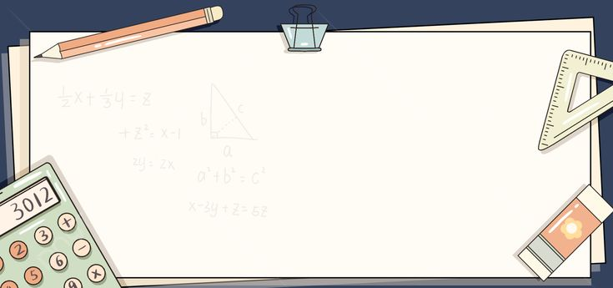
Calculator

Slide 3
What is Calculator ?

Slide 4
Function Definitions:
Print Menu Options:
User Input:
Validate User Input:
Perform Operation:
Display Result:
Exit:

Slide 5
Elaboration
1.Function Definitions:
We define four functions: add, subtract, multiply, and divide, each taking two parameters (x and y) representing the numbers to operate on. These functions perform addition, subtraction, multiplication, and division respectively. Each function has a docstring explaining what it does.

Slide 6
2. Print Menu Options:
The program displays a menu of operations for the user to choose from using print() statements.
3. User Input:
The program prompts the user to enter their choice of operation by using the input() function. It also prompts the user to enter two numbers to perform the chosen operation on.

Slide 7
4. Validate User Input:
It checks if the user's choice is valid by using a while loop. The loop will continue until the user enters a valid choice (1, 2, 3, or 4).If the input is not valid, it prints "Invalid Input" and prompts the user again.
5. Perform Operation:
Once the user enters a valid choice, the program converts the input strings to integer-point numbers using int().Based on the user's choice, it calls the corresponding function (add, subtract, multiply, or divide) passing the entered numbers as arguments.

Slide 8
6. Display Result:
The result of the operation is printed to the console using print() statements. If the user tries to divide by zero, an error message is displayed instead of crashing the program.
7. Exit:
After displaying the result, the program breaks out of the loop, effectively ending the program. If the user wants to perform another calculation, they can rerun the program.

Slide 9
Thank You

